Slide 1
Modeling and verifying security protocol using PAT approach
Luu Anh Tuan

Slide 2
Security protocol
Intruder

Slide 3
Intruder behaviors
Overhead and intercept any messages being passed in the system
Decrypt messages that are encrypted with his public key so as to learn new knowledge
Introduce new messages into the systems, using his knowledge he knows
Replay any message he has seen (possibly changing plain-text parts), even if he does not understand the contents of the encrypted part.

Slide 4
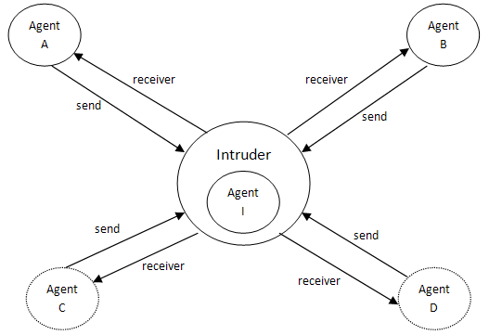
Network together (Dolev-Yao model)
System = (|||_{X} Agent_{X} ) |[send_message,receive_message]| Intruder
Notes:
Dolev-Yao model

Slide 5
Security goals
Authentication: confirm something/someone as authentic
Secrecy: prevent the intruder from deriving secret information
Non-repudiation: the author of a message cannot later claim not to be the author
Integrity: any message corruption will always be detected
Anonymity: the identity of an agent is protected with respect to the message he sent
Fairness: each player receives the item it expects and neither player receives any additional information about other’s item

Slide 6
Security module in PAT
Easy for user to specify and verify → SEVE language.
Has the powerful expressiveness, but still be friendly with the user
Fully automatic specification and verification
Support many kinds of security goals verification and user requirement
Flexibility and adaptability

Slide 7
Framework for SEVE module (translator way)
User specification using SEVE language
Blackbox with the user
Automatic translation from SEVE language to PAT language
Adding intruder behavior and specification
Using PAT tool to check the security requirement
Verification output to user
Transformation from counter example (if have) to human reading form

Slide 8
Framework for SEVE module (direct way)
User specification using SEVE language
Adding intruder behavior and specification
Compiling and System analysis
Transformation from counter example (if have) to human reading form
Blackbox with the user
Verification output to user

Slide 9
An example: Needham-Schroeder protocol
A
B
{A,N_{A}}_{pkB}
{N_{A},N_{B}}_{pkA}
{N_{B}}_{pkB}

Slide 10
SEVE language
Declaration language.
Easy to specify as similar with security protocol declaration.
#Variables
Agents: a,b;
Nonces: na,nb;
Public_keys: {ka,kb};
#Initial declare
a knows {na,ka};
b knows {nb,kb};
#Protocol description
a -> b : {a, na}kb;
b -> a : {na, nb}ka;
a -> b : {nb}kb;
Declaration part

Slide 11
SEVE language
#System
Initiator: Alice;
Responder: Bob;
Intruder: Caron;
#Verification
Secrecy: {ka} of Alice
Agent authentication:
Alice is authenticated with Bob using {na}
Alice sends na before Bob sends nb
Actual system part
Verification part

Slide 12
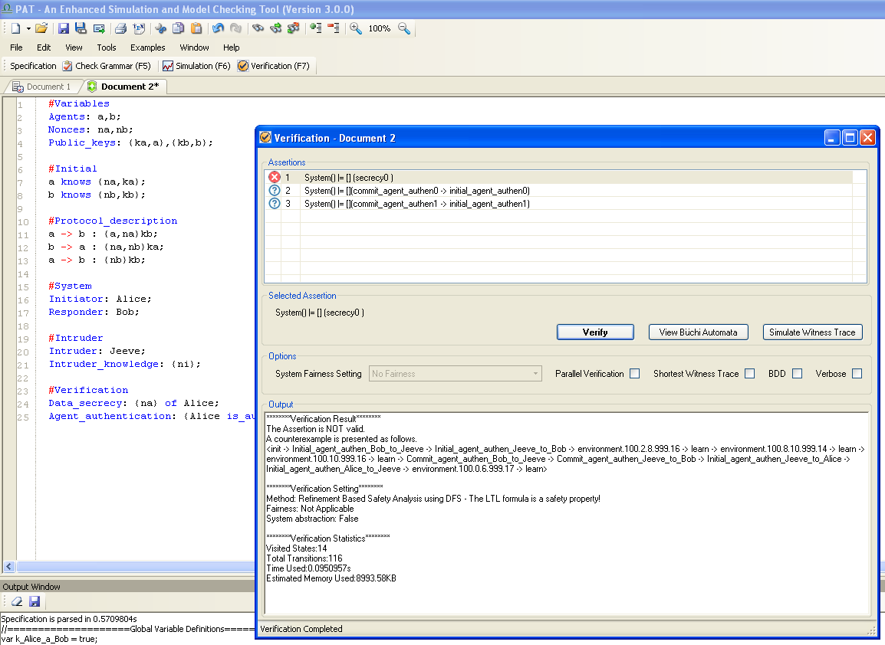

Slide 13
An attack on the Needham protocol
{A,N_{A}}_{pkI}
{A,N_{A}}_{pkB}
{N_{A},N_{B}}_{pkA}
{N_{A},N_{B}}_{pkA}
{N_{B}}_{pkI}
{N_{B}}_{pkB}

Slide 14
Future work
Build in the time model semantic for security program.
Support others cryptography scheme: Diffle-Hellman key agreements, hash key function.
Apply some techniques to reduce the state space: symmetry reduction …
Support not only for security protocols but also for other transaction protocols, e.g. network layer.

Slide 15
Thank you
Q & A

